Slide 1

Smart Parking Management System
Real-time occupancy • Online bookings • Reduced congestion

Slide 2
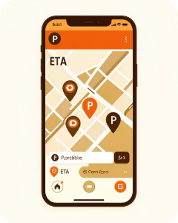
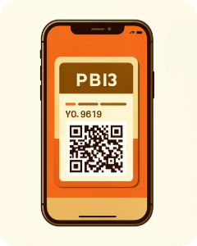
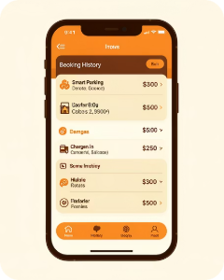

Customer Experience — Mobile Front End
Find & Reserve
Check-in / Check-out
Dashboard
Map view • Real-time availability • Instant booking
Booking history • Payment receipts • Vehicle profiles
QR access • Automated time logs

Slide 3

Admin Portal — Operations
Slot Management
Pricing
Reports
Dynamic charges • Time-based rules
Utilization, revenue, incidents
View / Reserve / Release slots
Integrates with sensors, payment gateway, and enforcement tools

Slide 4
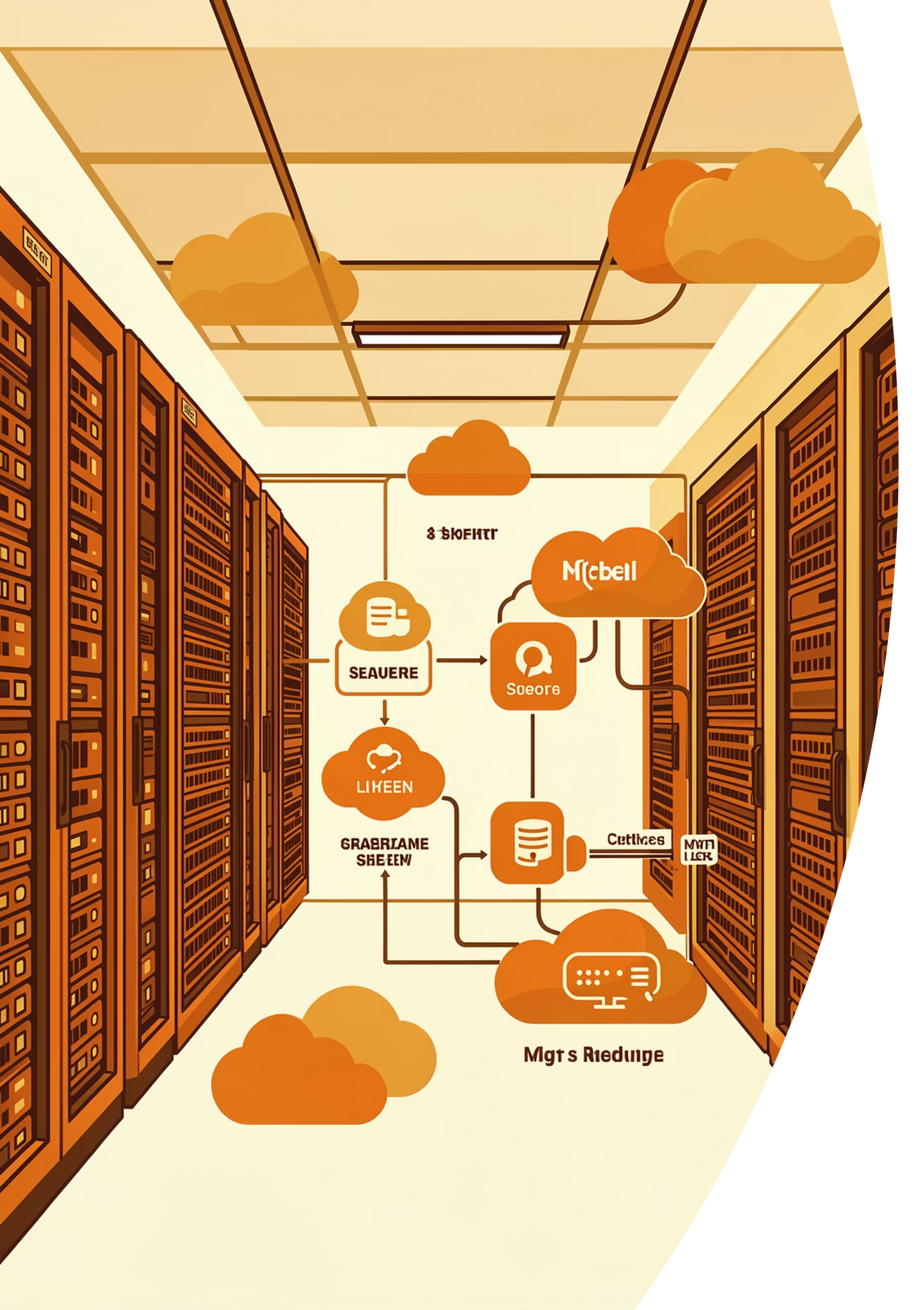

Backend Architecture
Database
MongoDB — flexible, geo-indexed parking data
Auth
Firebase Authentication — secure logins
API Layer
Java Spring microservices • REST / WebSocket for real-time updates

Slide 5

Detect Occupancy
Send to Gateway
Update Database
Push to App
End-to-end real-time pipeline. Low-latency updates via WebSocket.

Slide 6




Key Features — At a Glance
Real-time Availability
Online Booking
Utilization Analytics
Guidance & Routing
Designed for city-scale deployment and operator control

Slide 7
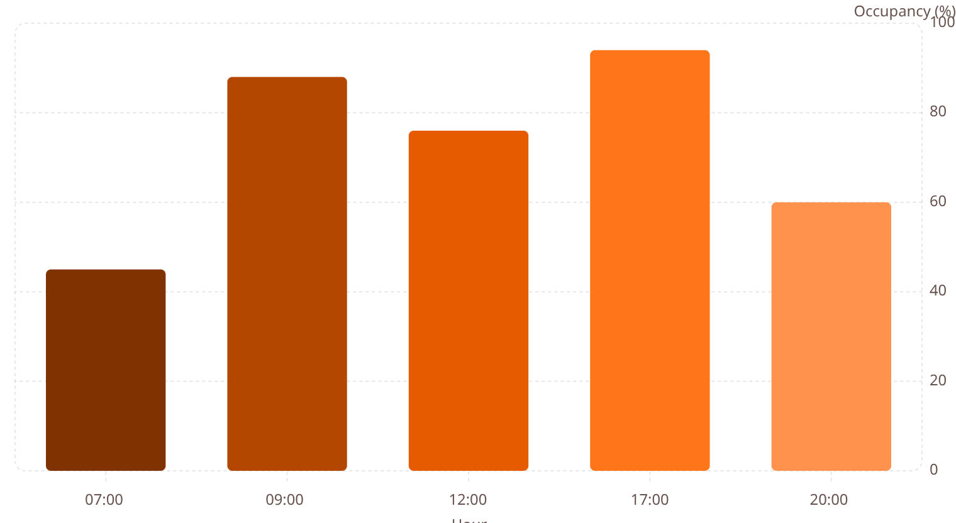
Utilization Pattern — Peak Hours
Data informs dynamic pricing, enforcement scheduling, and transit planning. Target: smooth peak congestion.

Slide 8

Benefits for Cities & Users
Saves time & fuel — lower emissions
Reduces cruising traffic and congestion
Improves space utilization and revenue
Digital records → fewer manual errors

Slide 9
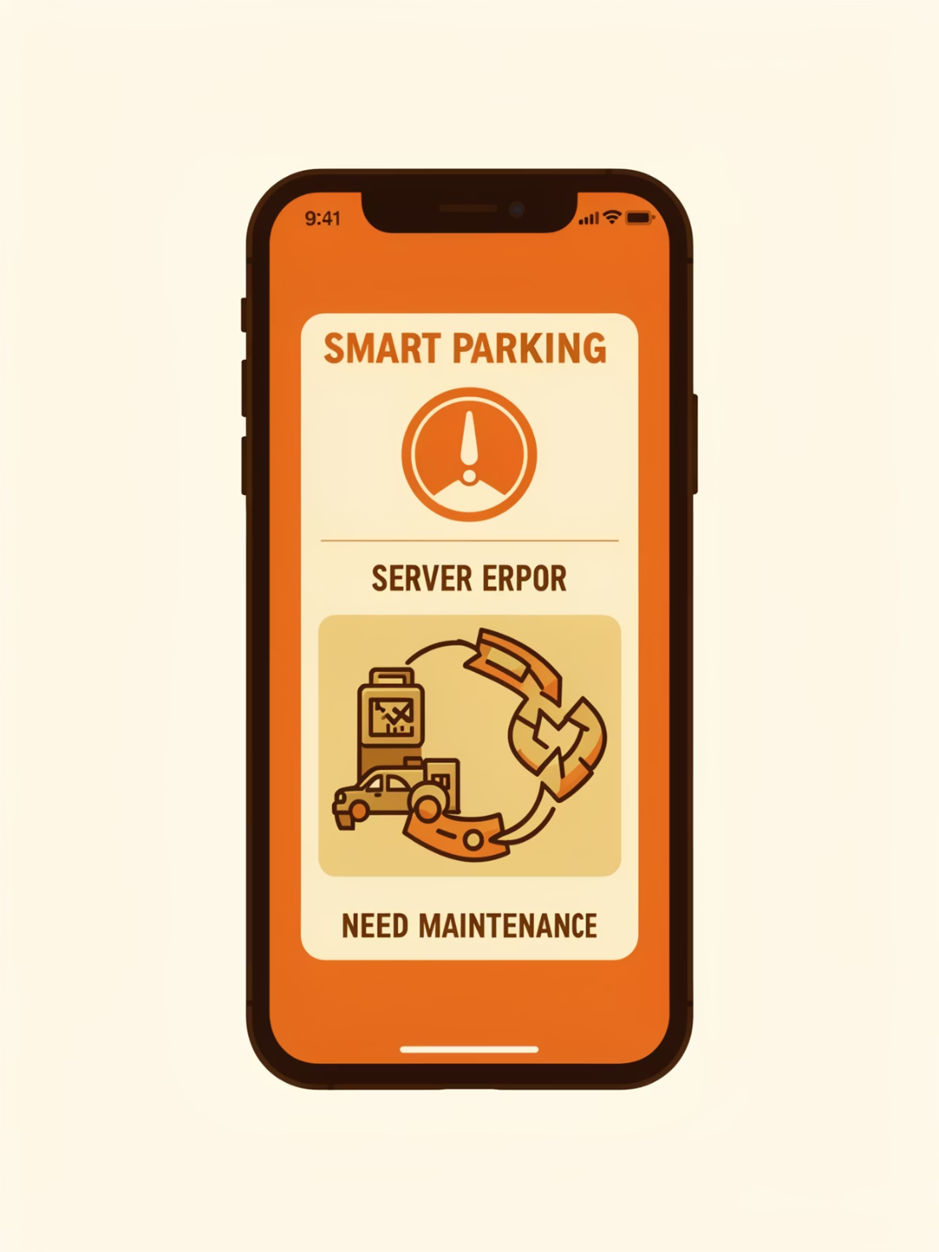
Risks & Limitations
Connectivity
Costs
Reliability & Security
Requires stable internet / cellular coverage
Installation & ongoing maintenance
Redundancy, backups, and data protection needed
Mitigations: offline caching, SLA-backed connectivity, encrypted data storage

Slide 10


Next Steps & Recommendation
Pilot
Small district deployment • 3 months
Scale
Phase rollout • integrate enforcement
Optimize
Dynamic pricing • analytics-driven policy
Proposal: pilot with 200 sensors, operator dashboard, and public app. Budget estimate and timeline available on request.

